Slide 1
Mastering Blockchain Third Edition
Chapter 22, Current Landscape and What’s Next

Slide 2
Outline
Emerging trends
Areas to address
Blockchain research topics
Alternative blockchains
Blockchain, AI, and other technologies
The future of blockchain

Slide 3
Trends
ASBCs: Application-Specific Blockchains dedicated to one application
Consortia: consortium chains between enterprises
Education: new courses offered by educational establishments on blockchain technology
Enhancements: enhancing the existing blockchain protocol
Research: more research for the betterment of existing blockchain technology
Research on cryptography
Security research
BaaS: Blockchain as a Service

Slide 4
Debatable ideas and areas to address
Public versus private on the blockchain
Pros and cons of both for different applications
Some inclination towards using public chains for enterprise use cases
CBDCs
Central Bank-issued Digital Currencies: do these go against the decentralized spirit of blockchain?
Illegal activity
Tracking illegal activity on a blockchain is difficult if advanced cryptography such as zero-knowledge proofs are used for anonymity and confidentiality
Privacy or transparency
A fine balance between privacy and transparency is required
Too much privacy means a loss of transparency and vice versa: too much transparency means a loss of personal privacy

Slide 5
Blockchain research
Smart contracts
There is ongoing research to make smart contracts more usable
Filling the gap between government law, and the blockchain idea that the code is law
Cryptographic function limitations
Quantum resistance
There are still fundamental or unexplored flaws in core cryptography protocols that need to be addressed for Blockchain technology to be widely adopted
Consensus algorithms
Proof of Stake
Scalability
DAG
Hashgraph
Code obfuscation
Confidentiality and privacy

Slide 6
Alternative blockchains
Many alternative blockchains have emerged in recent years, with their own core goals, ideologies and frameworks. A few that we’ll discuss here are:
Kadena
EOS
Tezos

Slide 7
Consensus in Kadena
Kadena is a blockchain that has successfully addressed scalability and privacy issues. A key innovation in Kadena is its scalable Byzantine Fault Tolerant (BFT) consensus algorithm, which has the potential to scale to thousands of nodes without performance degradation.
Kadena’s scalable BFT consensus algorithm

Slide 8
Pact
A new Turing-incomplete language, called Pact, has also been introduced with Kadena that is used for developing smart contracts. Some sample Pact code is shown below

Slide 9
EOS
EOS high-level architecture
The EOS blockchain was developed by block.one using the C++ programming language.
It was built for both public and private blockchain use cases
A new concept of system resources has been introduced with EOS. Just like the usual concept of computing resources in a computer, such as RAM, CPU, and networking (NET), the EOS blockchain uses the same concept of resources to manage the blockchain
The amount of resources allocated is directly proportional to the amount of EOS stake—meaning the higher the stake, the more the resources you get. This resource model protects against abuse because in order to game the system, an attacker would need a large stake

Slide 10
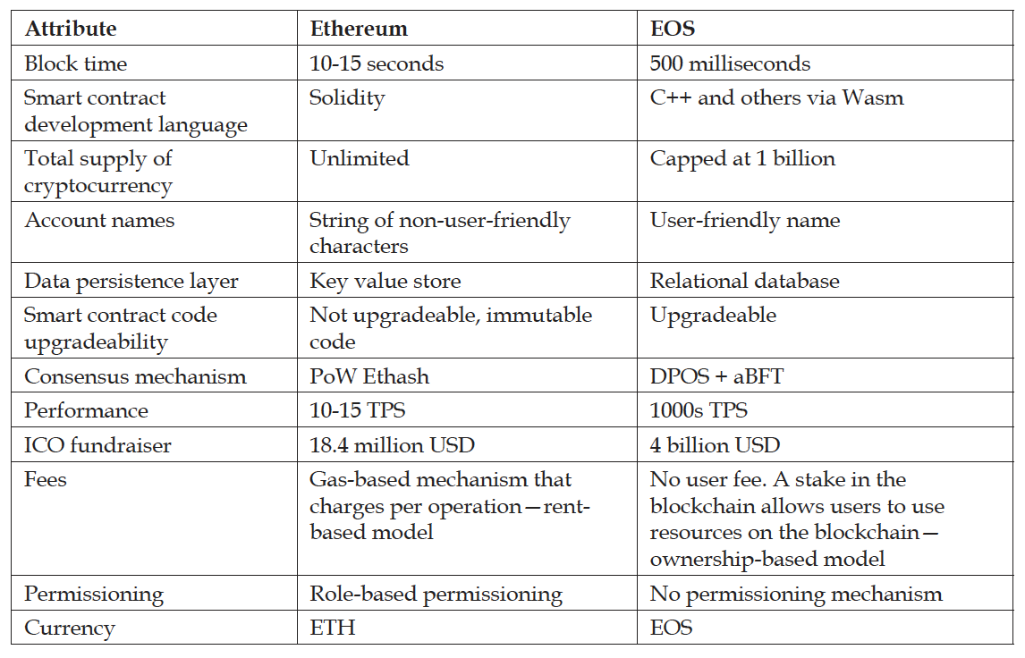
EOS and Ethereum
EOS is sometimes seen as a competitor to Ethereum. Some comparisons between the two chains are made below

Slide 11
Tezos
Tezos is a generic self-amending cryptographic ledger, which means that it not only allows decentralized consensus on the state of the blockchain but also allows consensus on how the protocol and nodes are evolved over time. It has the following properties and components:
Self-amending
Network layer
Consensus layer
Transaction layer
Nodes
Bakers
Endorsers

Slide 12
Tezos
Tezos was developed to address limitations in the Bitcoin protocol (and other similar blockchains), such as contentious issues arising from hard forks, cost and mining power centralization due to PoW, limited scripting ability, and security issues. It has been developed in a purely functional language called OCaml.
Its high-level architecture can be seen below

Slide 13
Blockchain, AI, and other technologies
Convergence with other technologies, especially with AI and IoT is inevitable.
Machine learning plays a vital role in AI technology, by making use of raw data as a learning resource. The explosion of data coming out of IoT devices, smartphones, and other means of data acquisition means that AI and machine learning is becoming more and more powerful.
There is, however, a requirement for data authenticity, which is where the convergence with blockchain comes in. Once consumers, producers, and other entities are on a blockchain, the data that is generated can be readily used as an input to machine learning engines with a guarantee of authenticity.

Slide 14
Future of blockchain
Predictions
DeFi is the future, with billions of dollars locked in value
Blockchains to be commonly used on a day to day basis, just like the internet is today
Research on novel and innovative cryptography protocols
Convergence with other technologies
AI and IoT

Slide 15
Summary
In this presentation, we considered some of the following concepts in regards to the future of blockchain technology:
Trends
Debatable ideas and areas to address
Research topics
Alternative blockchains
Blockchain, AI, and other technologies
Some predictions about the future of blockchain!

